Slide 1
PBL Project 24 Group-3

Slide 2
Project Aim
The aim of the project is to predict Wine Quality using machine learning models. The main goal of this machine learning project is to build a machine learning model to predict the quality of wines by exploring their various chemical properties.
Dataset used: The dataset that has been used for this project is wine quality dataset.

Slide 3
Random Forest Classifier
Random Forest is a popular machine learning algorithm which is a supervised learning technique. It can be used for both Classification and Regression problems. It is based on the concept of ensemble learning, which is a process of combining multiple classifiers to solve a complex problem and to improve the performance of the model.
As the name suggests, "Random Forest is a classifier that contains a number of decision trees on various subsets of the given dataset and takes the average to improve the predictive accuracy of that dataset." Instead of relying on one decision tree, the random forest takes the prediction from each tree and based on the majority votes of predictions, and it predicts the final output.
The greater number of trees in the forest leads to higher accuracy and prevents the problem of overfitting.

Slide 4
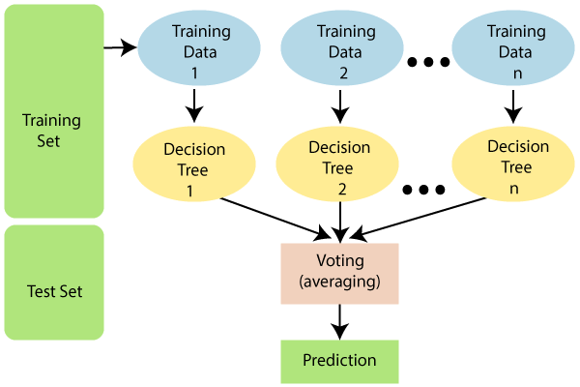

Slide 5
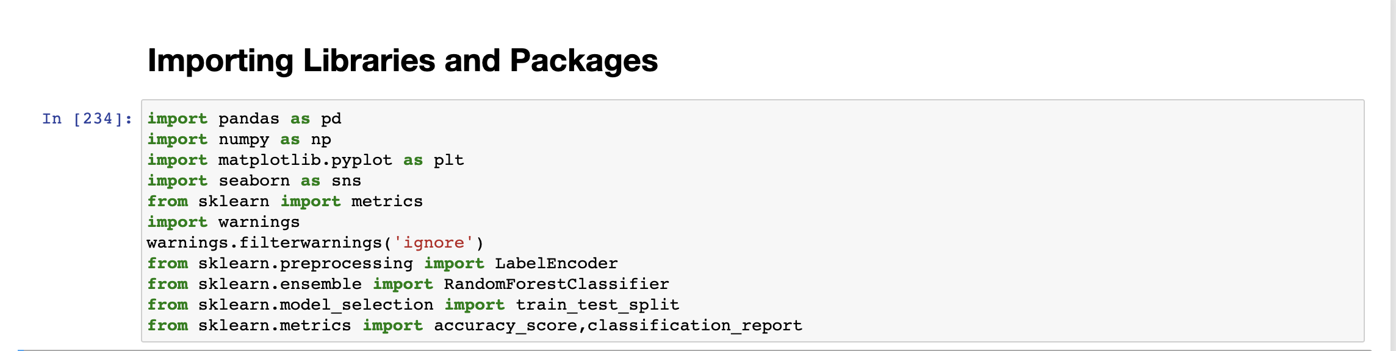
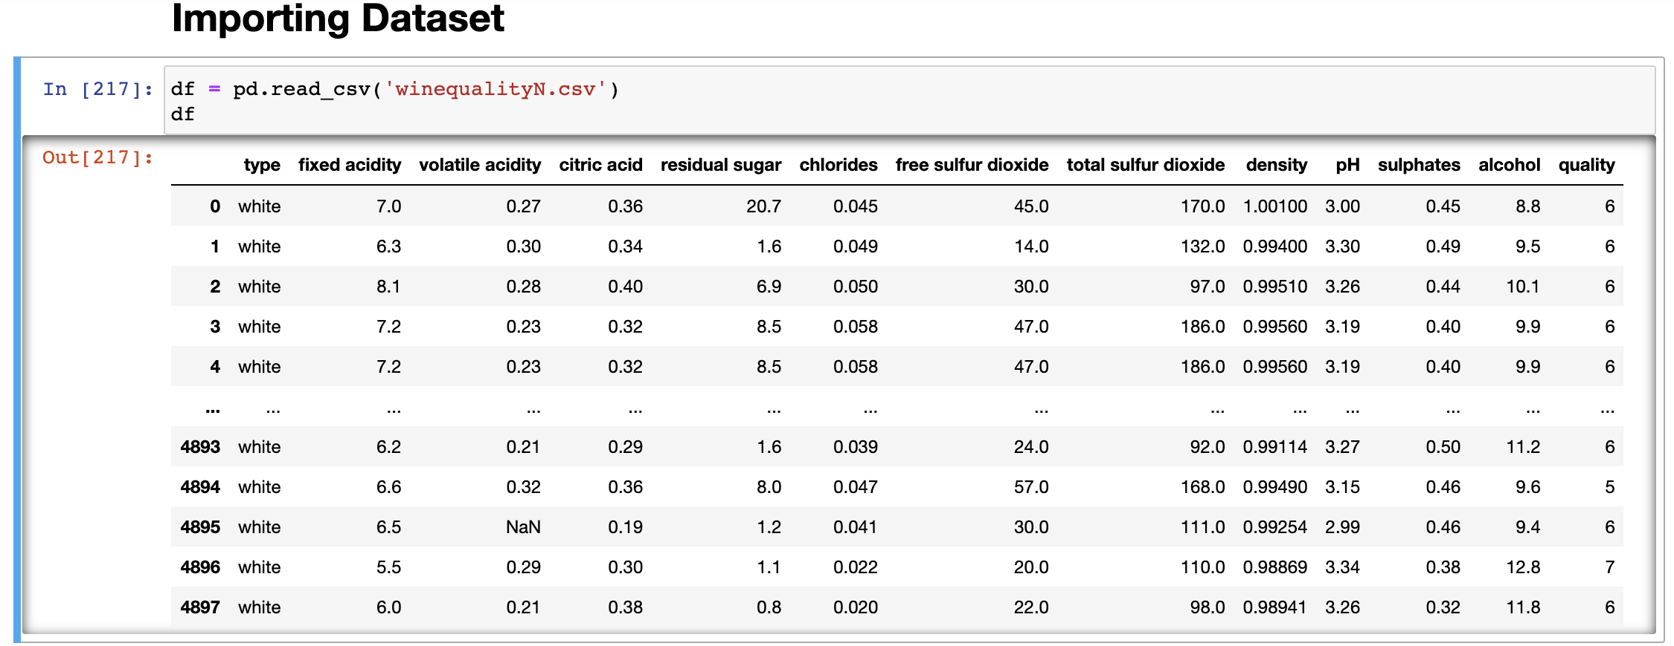
Importing Libraries and Dataset

Slide 6
Preprocessing
Data preprocessing is a crucial step that helps to enhance the quality of data to extract meaningful insights from the data. Data preprocessing refers to the technique of preparing (cleaning and organizing) the raw data to make it suitable for a building and training models. In simple words, data preprocessing is a data mining technique that transforms raw data into an understandable and readable format.
df.head()
df.info()
df.describe()
df.isnull().sum()

Slide 7
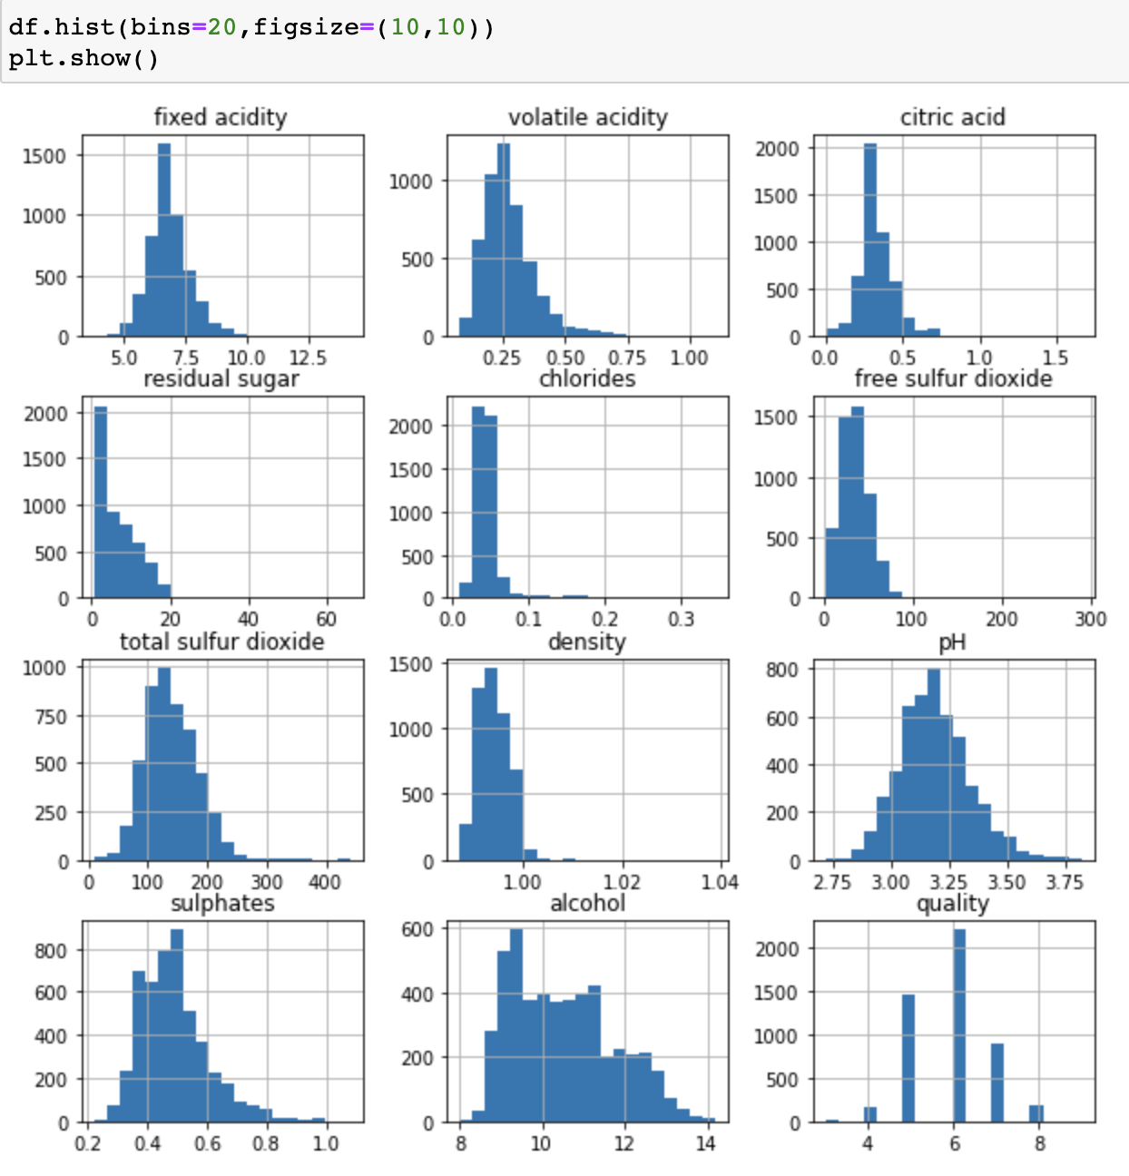
Data Visualization: Histogram

Slide 8
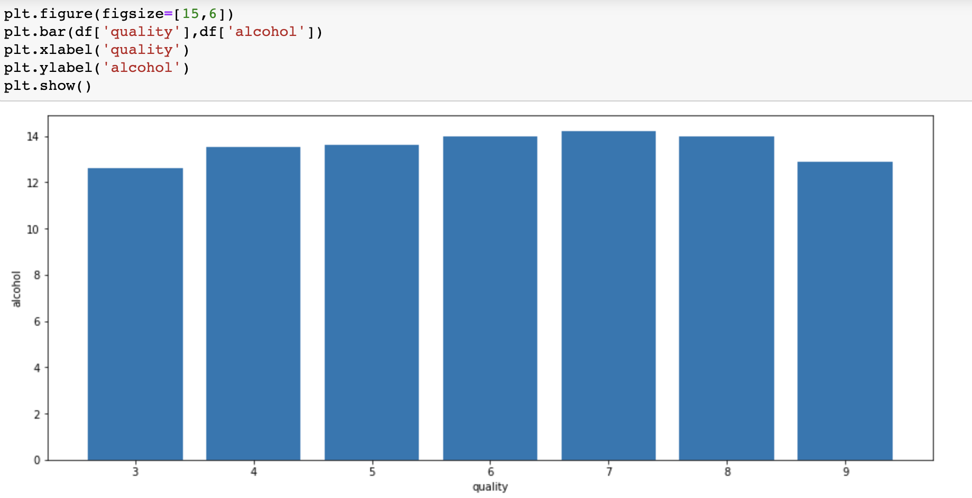
Bar Graph

Slide 9
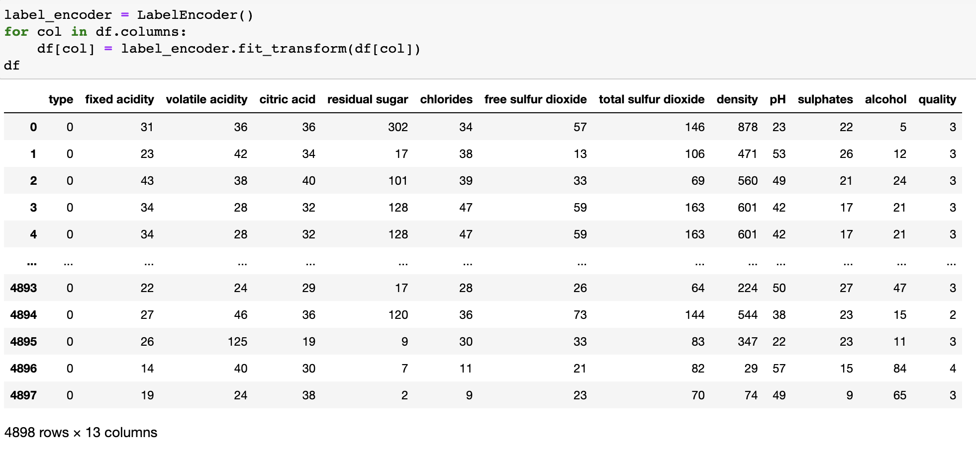
Label Encoding
Label Encoding refers to converting the labels into a numeric form so as to convert them into the machine-readable form. Machine learning algorithms can then decide in a better way how those labels must be operated. It is an important pre-processing step for the structured dataset in supervised learning.

Slide 10
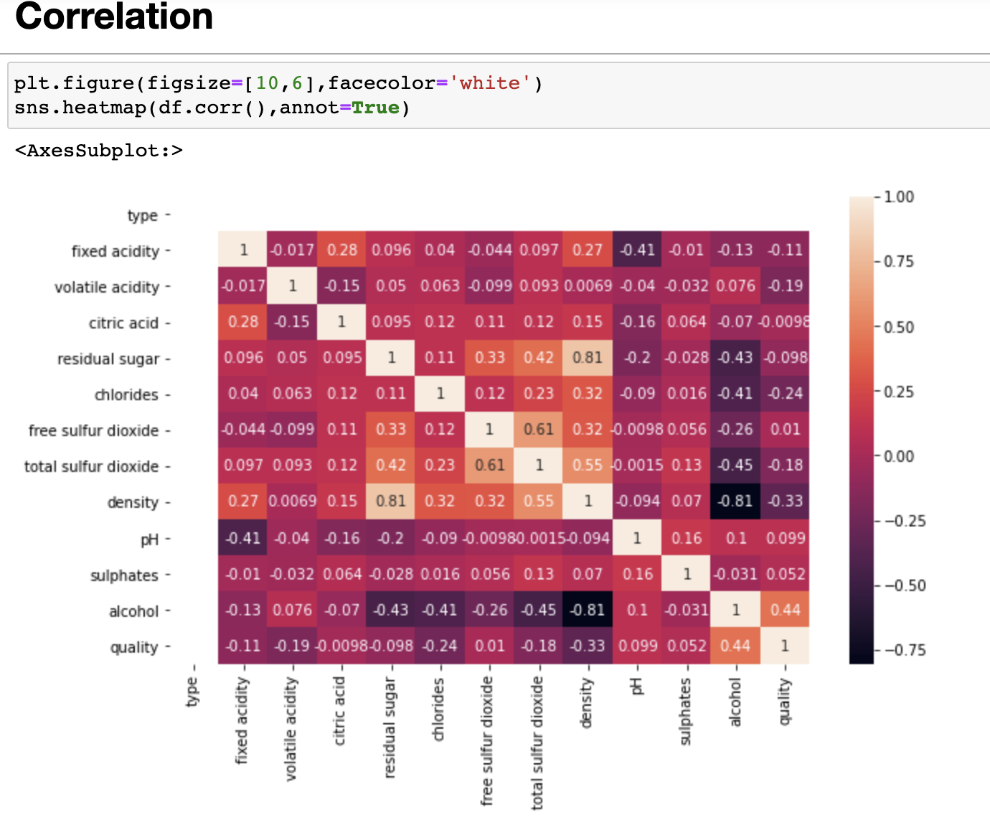
Correlation

Slide 11
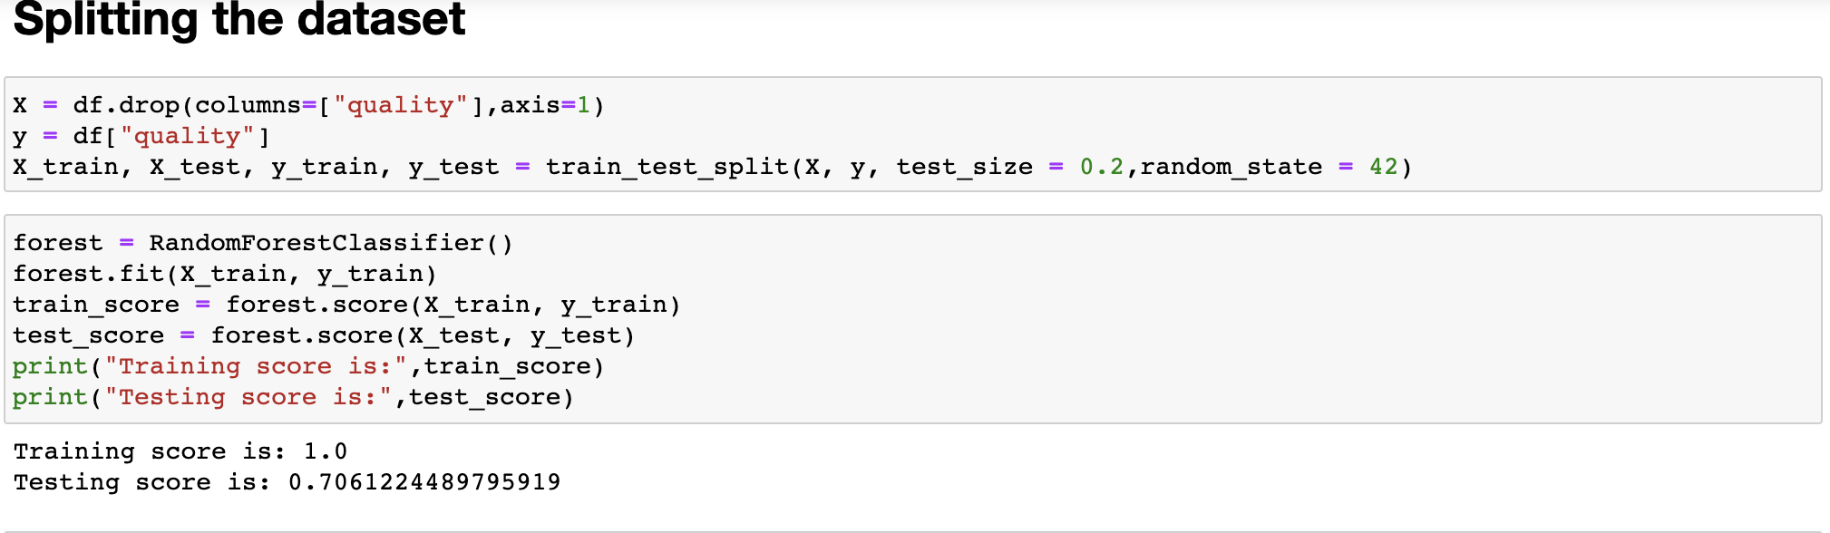
Splitting the dataset and obtaining training and testing score

Slide 12
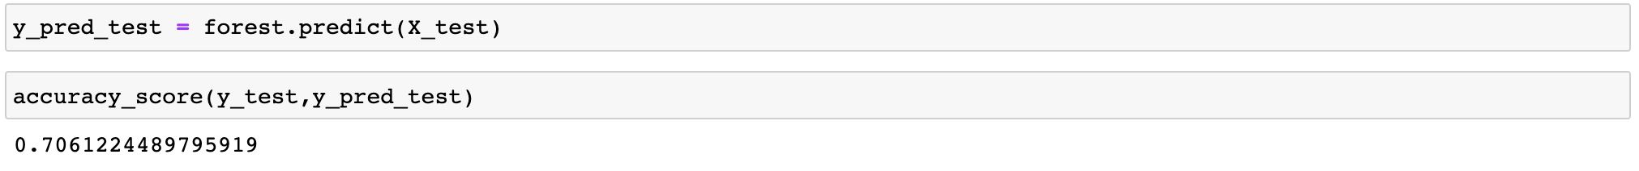
Predicting the accuracy of the model

Slide 13
Thank you

